Slide 1
Lesson Two
Create MVC Web Application With Authentication
Dragos Rosca
Automatica si Calculatoare 2018

Slide 2
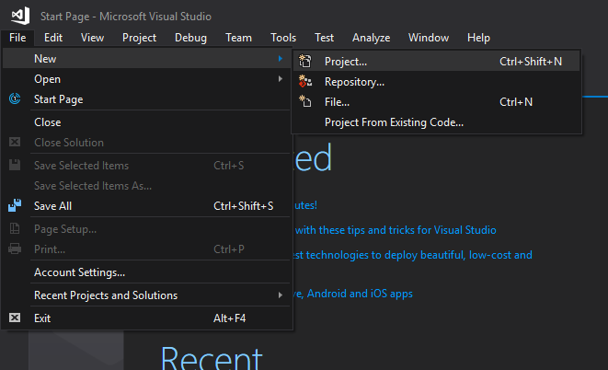
Create Project
Open File menu
Choose New
Click Project…
Or use the shortcut
Ctrl + Shift + N
This requires that your environment settings are set to C# developer

Slide 3
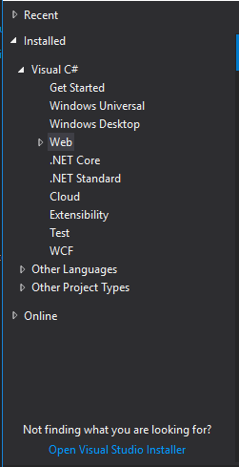
Create Project
On the left menu, expand:
Installed
Visual C#
Web

Slide 4
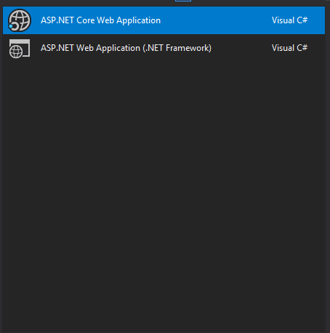
Create Project
On the middle part select
ASP.NET Core Web Application

Slide 5
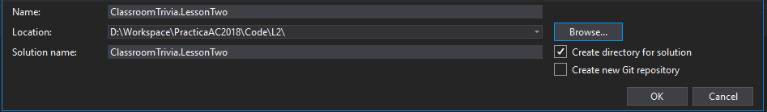
Create Project
On the bottom please name your application and choose a location

Slide 6
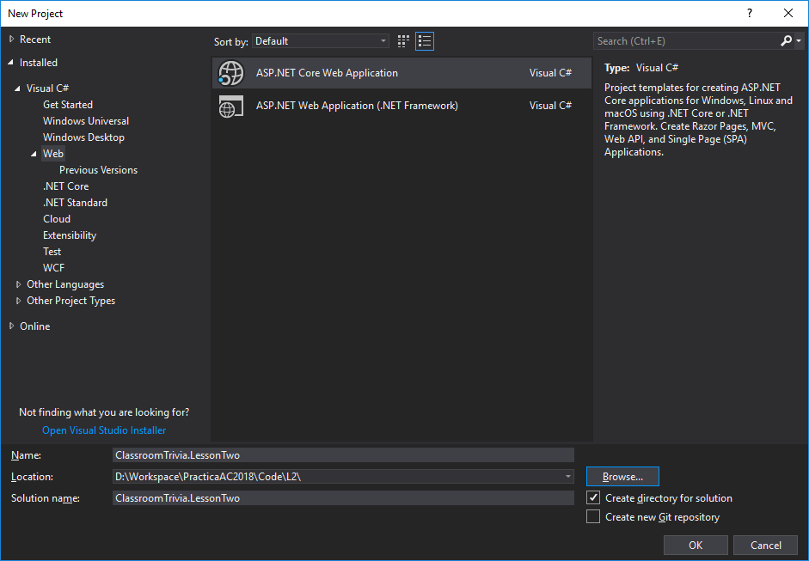
Create Project
Click OK

Slide 7
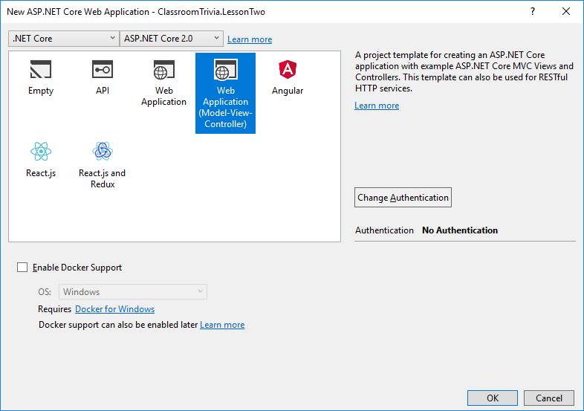
Create Project
On the next window choose “Web Application (Model-View-Controller)”
Please make sure that on the top you have selected
.NET Core
ASP.NET Core 2.0
Click Change Authentication

Slide 8
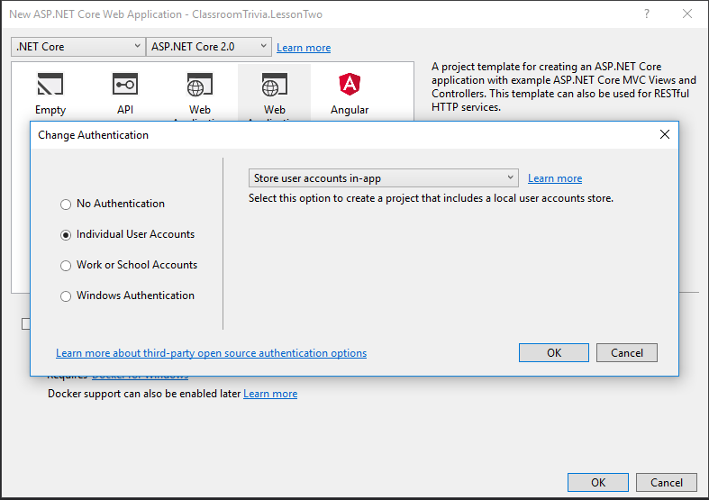
Create Project
Select Individual User Accounts
Click OK on both windows

Slide 9
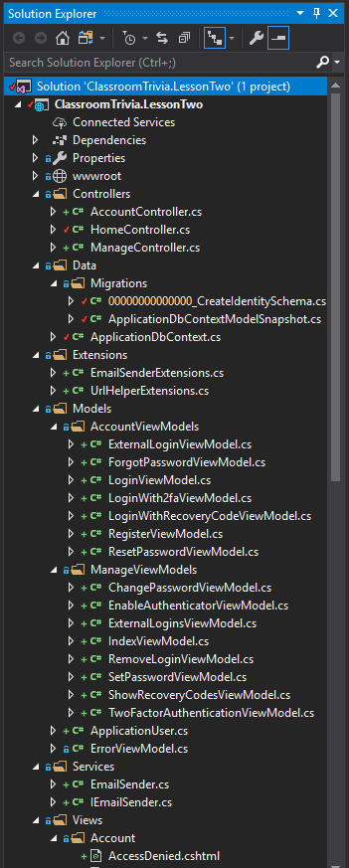
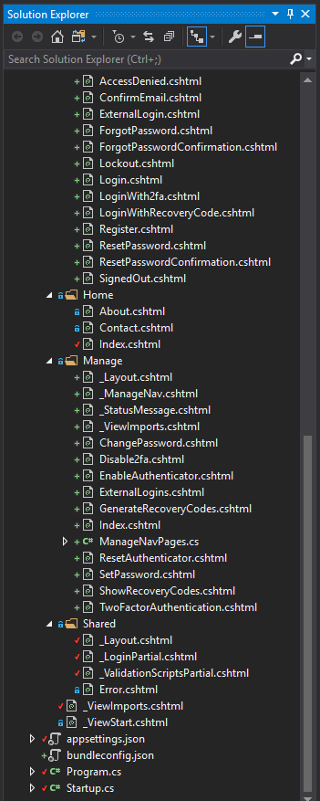
Create Project
At this point your Solution Explorer window should look like this

Slide 10
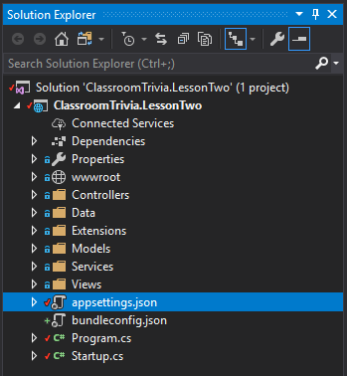
Set Database Connection
Open appsettings.json file
Change the default connection string to point to your database

Slide 11
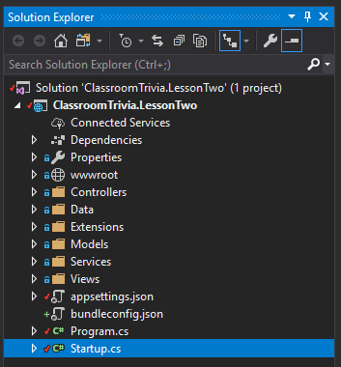
Migrate Database
Open Startup.cs file
Find the Configure method
Add a extra parameter of type IServiceProvider named service
Change from
To

Slide 12

Migrate Database
At the end of the Configure method we need to add the following code
From the service parameter get a instance of the context object
var context = service.GetService<ApplicationDbContext>();
With this context you can access the database and perform a migration
context.Database.Migrate();

Slide 13
Create Roles
At the end of the Startup class we will add a new method called CreateUserRoles
This class will need to access some services that are registered in the application’s service provider, because of this we will request a parameter of type IServiceProvider
private async Task CreateUserRoles(IServiceProvider service)

Slide 14
Create Roles
First we will request from the service provider a instance of the role manager.
var roleManager = service.GetRequiredService<RoleManager<IdentityRole>>();
In case our roles don’t exist we will create them and because this action returns a IdentityResult object we will create a variable of this type so we can look at the result
IdentityResult identityResult;

Slide 15
Create Roles
We will first check if the role exists
var roleExists = await roleManager.RoleExistsAsync("Admin");
Then we will check if it doesn’t exist so we can create it
if (!roleExists)
If the role doesn’t exist we will create a role object with the name Admin
var adminRole = new IdentityRole("Admin");
Now we will use the role manager to create the admin role in the database
identityResult = await roleManager.CreateAsync(adminRole);
This steps will be repeated for the professor and student roles

Slide 16
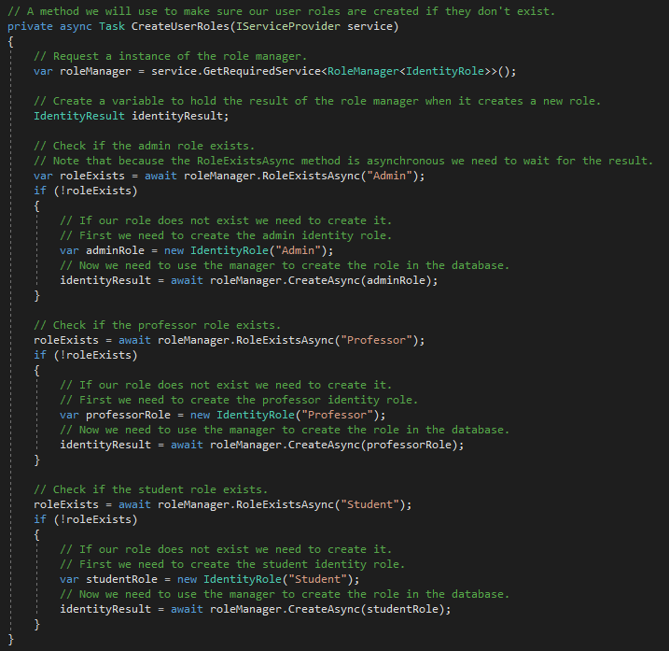
Create Roles
The final CreateUserRoles method should look something like this

Slide 17

Create Roles
Now we will call our CreateUserRoles method at the end of the Configure method.
We will give it the required parameter and we will wait for it to run because it is asynchronous.
CreateUserRoles(service).Wait();

Slide 18
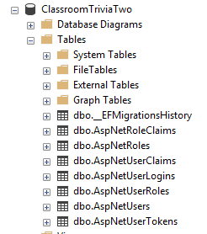
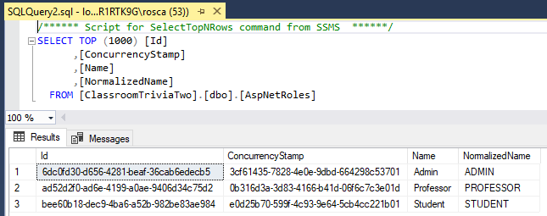
Check the Roles
Now we can run the application and look in the database

Slide 19
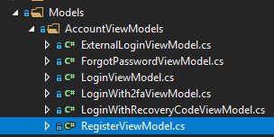
Change The Registration
In the Models folder, expand the AccountViewModels and open the RegisterViewModel

Slide 20
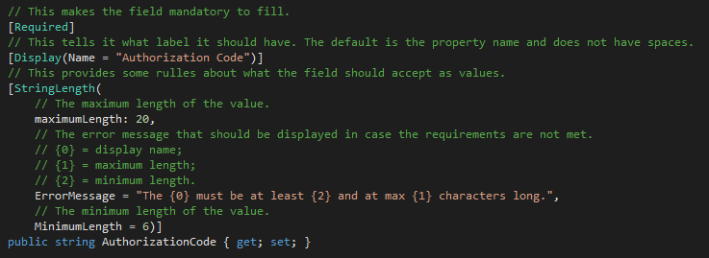
Change The Registration
In this class add the AuthorizationCode property of type string with the following decorations
[Required]
Makes the field mandatory
[Display(Name = "Authorization Code")]
Sets the name that should be displayed
[StringLength(maximumLength: 20, ErrorMessage = "The {0} must be at least {2} and at max {1} characters long.", MinimumLength = 6)]
Sets rules for the values you are allowed to insert

Slide 21
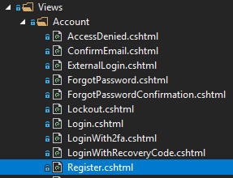
Change The Registration
In the Views folder, expand the Account and open the Register

Slide 22

Change The Registration
We will add a new div form group with the new field.
The div will contain
A label for the display name
An input to insert the value
A span tag that will be filled with the error message that will be displayed in case the validation fails
We use the “text-danger” class to make the text red and look like an error
<div class="form-group">
<label asp-for="AuthorizationCode"></label>
<input asp-for="AuthorizationCode" class="form-control" />
<span asp-validation-for="AuthorizationCode" class="text-danger"></span>
</div>

Slide 23


Change The Registration
In the Controllers folder we will open the AccountsControlle class
Find the Register method that is called on a Post call

Slide 24
Change The Registration
At the beginning of the method we will add our code that we agreed upon
If the authentication code starts with “A” it’s an administrator
For “P” it’s a professor
For “S” it’s a student
Else it’s not valid
var role = string.Empty;
if (model.AuthorizationCode.StartsWith("A", StringComparison.InvariantCultureIgnoreCase))
{
role = "Admin";
}
else if (model.AuthorizationCode.StartsWith("P", StringComparison.InvariantCultureIgnoreCase))
{
role = "Professor";
}
else if (model.AuthorizationCode.StartsWith("S", StringComparison.InvariantCultureIgnoreCase))
{
role = "Student";
}
else
{
ModelState.AddModelError(string.Empty, "Invalid Authorization Code.");
}

Slide 25
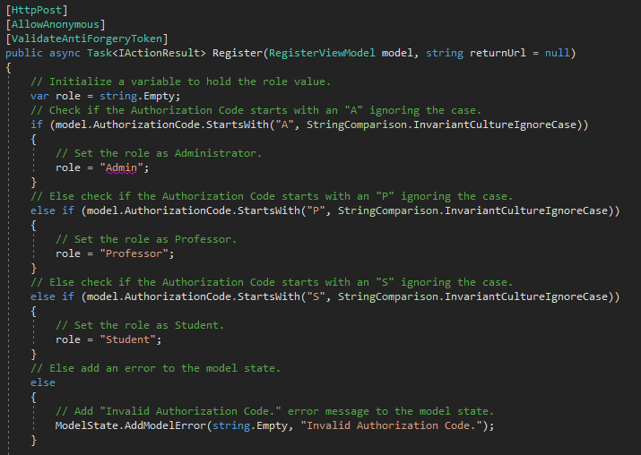
Change The Registration
The beginning of your method should look like this

Slide 26
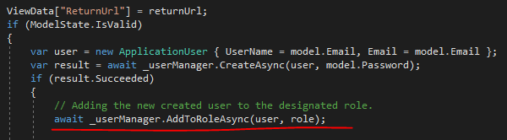
Change The Registration
In the same method, inside the “if (ModelState.IsValid)” true block, at the beginning of the “if (result.Succeeded)” true block add the following code
await _userManager.AddToRoleAsync(user, role);

Slide 27
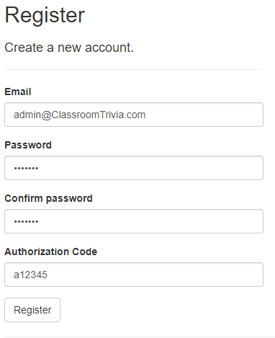
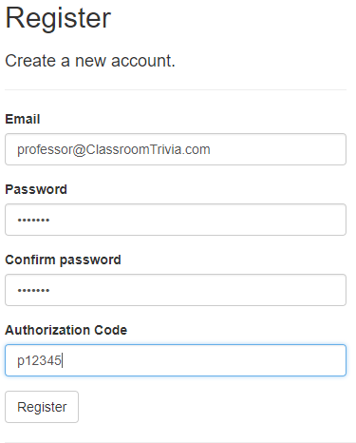
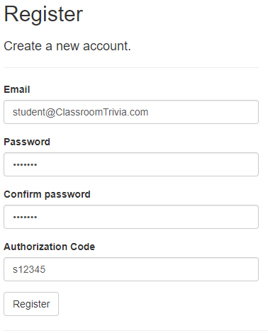
Change The Registration
At this point you should be able to run the application and register users

Slide 28
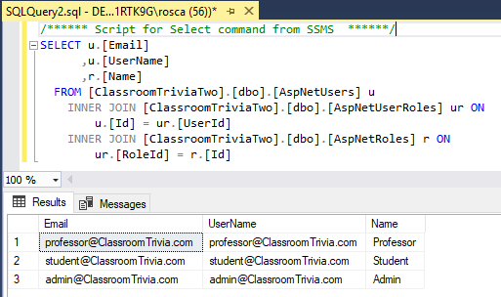
Change The Registration
This is a connection between the users table and the roles table

Slide 29
Lesson Two
Congratulation!
Automatica si Calculatoare 2018

